Slide 1
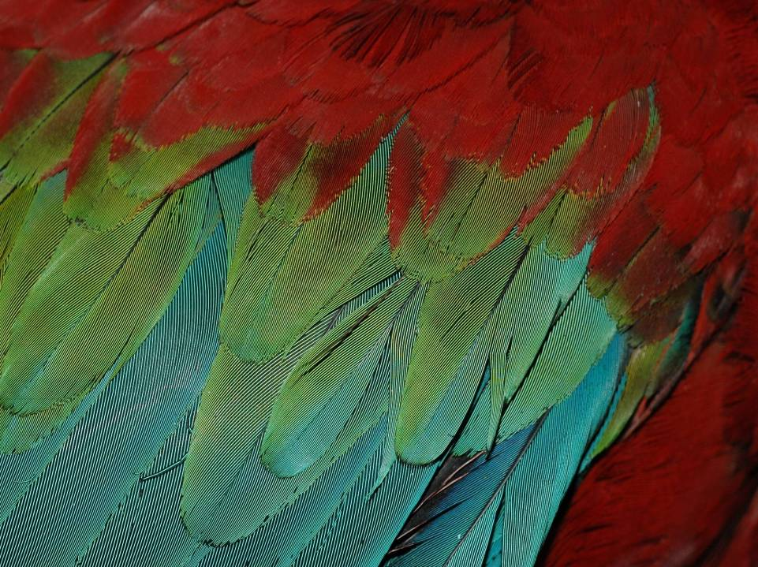
DNA testing of CITES species in the Czech Republic
Barbora Kaminiecka
Czech CITES Scientific Authority
Nature Conservation Agency of the Czech Republic

Slide 2
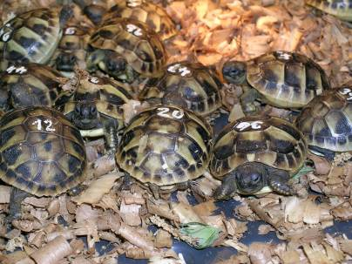
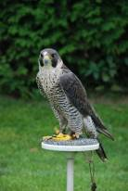
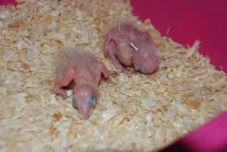
Why DNA testing? Czech Republic is a breeding world power
Breeding of animals is widespread hobby in the Czech Republic
Historical reasons: popular free time activity during comunistic period (mainly in 1970 – 1989). Possibility how to escape from reality
Currently:
Breeding as a hobby (expensive)
Breeding for trade – EU market is open
Most often: combination of both

Slide 3
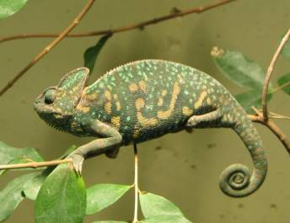
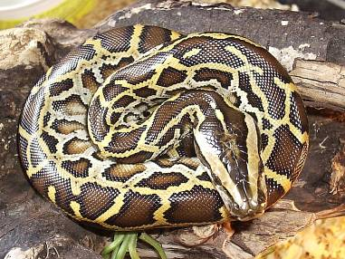
Example of trade - Annex B species
Export in 2012 – out of EU
Chamaeleo calyptratus – 10 000 specimen
Python molurus bivittatus – 1300 specimen
Platycercus spp. – 11 000 specimen
Trade in EU?

Slide 4
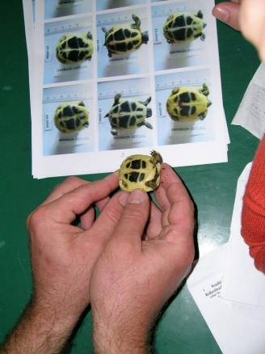
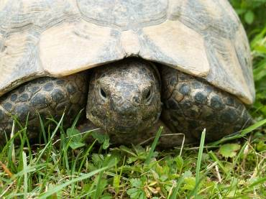
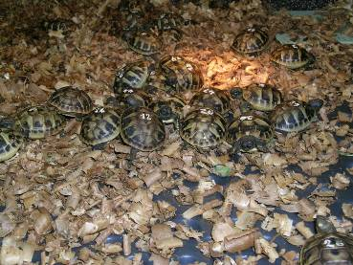
Breeding of Tortoises (Annex A)
Family Testudinidae – species bred in captivity regularly
Testudo hermanni: 2000 - 3000 annualy
Testudo marginata: 800 - 1300 annualy
Testudo greaca: 400 - 800 annualy

Slide 5
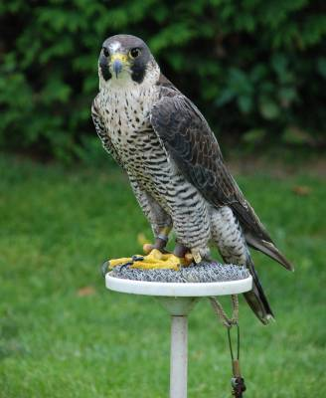
Breeding of Birds of prey
Falconry as a tradition and hobby
450 members of Czech and Moravian Falconry Association – one of the biggest in the world
Most popular species
Falco peregrinus – Peregrin Falcon
Falco cherrug – Saker Falcon
Falco rusticolus – Gyr Falcon
Accipiter gentilis - Goshawk
Aquila chrysaetos – Golden Eagle
Notes:
Historically also for Eagels and Falcons were DNA testing required. It was according to our national Nature protection law. Paid by Ministry of Environment
Producing of hybrids

Slide 6
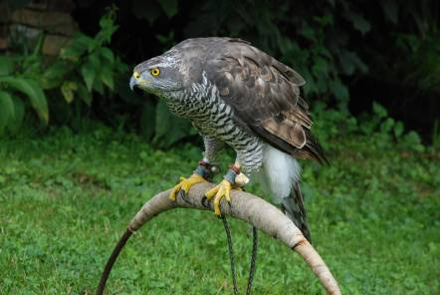
Is DNA testing justified?
Obligation is not included in national legislation
Prove of captive bred origin of specimen in accordance with art. 54 CR 865/2006
The option to use DNA tests in art. 55 in CR 865/2006
Notes:
We as Scientific Authority are dealing with

Slide 7
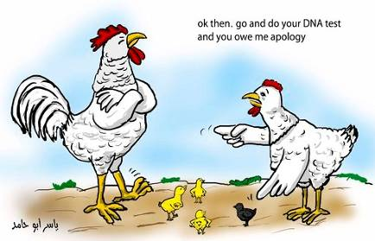
Proof of origin by DNA analysis
Criterions for paternity tests:
Rare species
Species is rarely or heavily bred in captivity
Species occurs in illegal trade
High market value

Slide 8
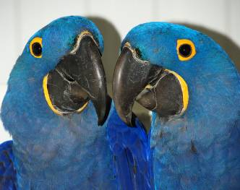
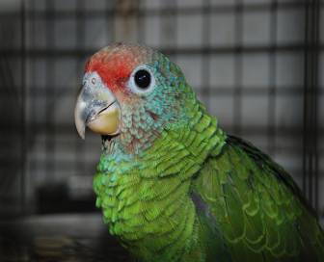
Proof of origin by DNA analysis
Obligatory for 9 species:
Anodorhynchus hyacinthinus
Amazona brasiliensis
Amazona pretrei
Amazona rhodocorytha
Accipiter gentilis (Goshawk)
Astrochelys radiata
Pyxis arachnoides
Pyxis planicauda
Malacochersus tornieri
Notes:
Since 2004 for Goshawks
Since 2008 for Parrots
Since 2010 for Tortoises
Since November 2013 we made some change and we are not so strict in case of clear evidences provided by breeders

Slide 9
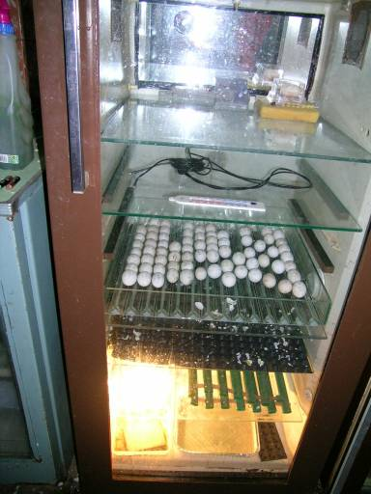
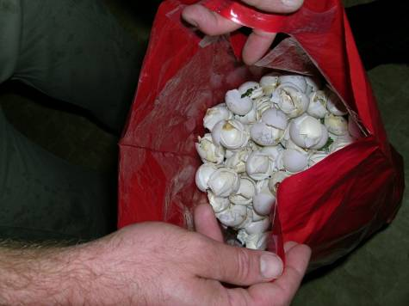
Proof of origin of Tortoises
Check of breeding facility

Slide 10
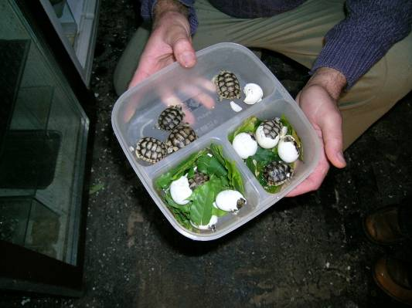
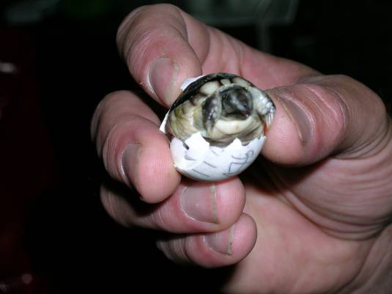
Proof of origin of Tortoises
Evidences produced by breeders
It seems credible

Slide 11
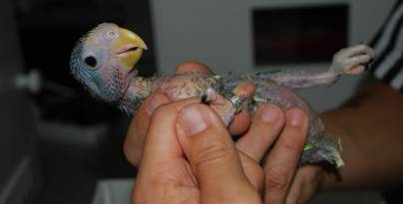
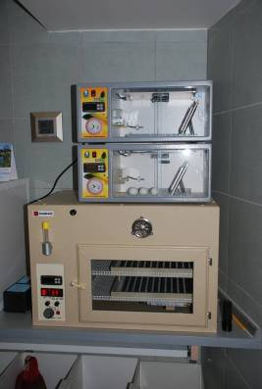
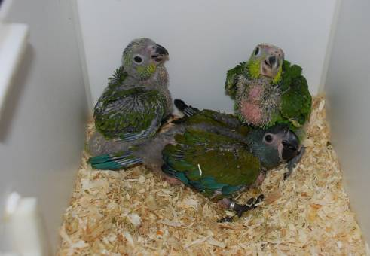
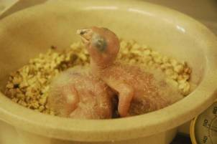
Proof of origin of Birds
Check of breeding facility – is it enough?
It seems also credible…

Slide 12
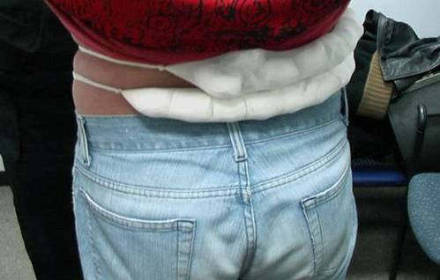
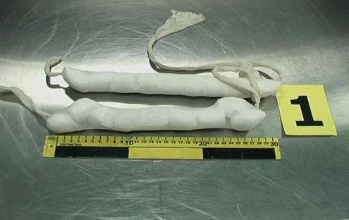
But…
This could be reality

Slide 13
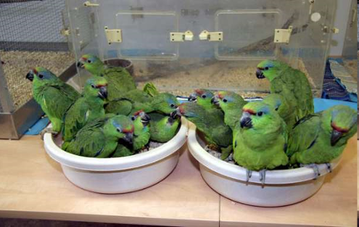
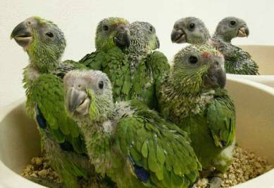
Some big cases of smuggling
2005: - 18 eggs of Amazona festiva festiva
- 3 eggs of Ara chloroptera
- 2 eggs of Ara severa
- 3 small Amazona collaria
- 2 small Amazona agilis

Slide 14
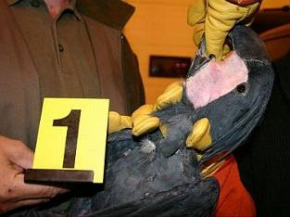
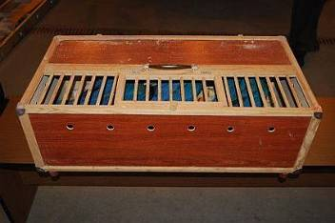
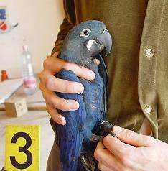
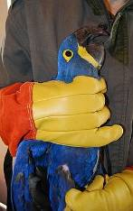
Some big cases of smuggling
May 2010: - 5 specimen of Probosciger aterrimus
June 2010: - 3 specimen of Anodorhynchus leari
- 5 specimens of Anodorhynchus hyacinthinus
- 3 specimens of Amazona brasiliensis
- 4 specimen of Amazona oratrix
- Ara ambiguus, Amazona rhodocorytha, Amazona tucumana
Notes:
Lear's Macaw – about 60 000 Euros
Hyacint Macaw – about 20 000 USD
Seized in the car and during several home searches

Slide 15
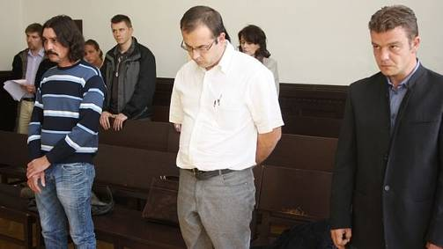
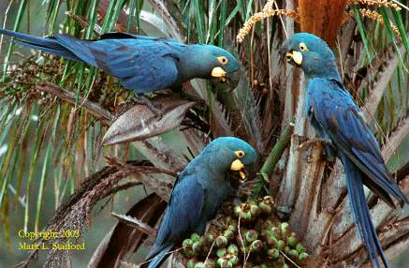
Result of this case: October 2013
One person sentenced to 4 years in prison
Two person sentenced to 3 years in prison
One person was given a one-year suspended sentence
Two main person died during investigation due to cancer
Notes:
The most succesfull case
punnishment

Slide 16
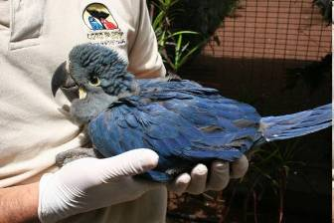
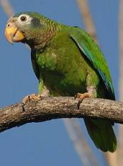
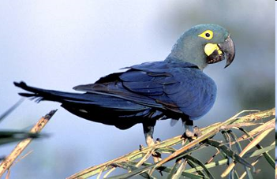
Is DNA testing justified?
Breeders, traders and smugglers are well organised - how many cases we missed?
We consider DNA testing as justified in our country
Other EU members:
Obligatory DNA testing: Netherlands, Belgium, Italy
Other countries: mostly case by case approach – in case of suspicion

Slide 17
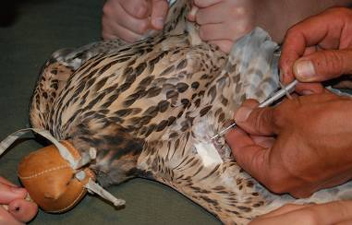
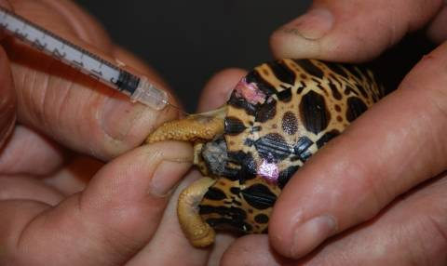
Methods of DNA testing
Samples – most often blood, fresh feathers, egg shells with rest of embryonal structures, salvia samples
Attendance of some CITES Authority is necessary
Only results from accredited laboratories are accepted

Slide 18
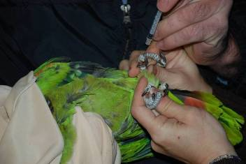
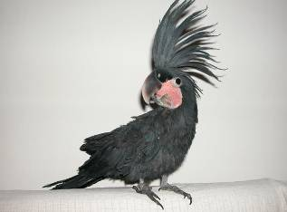
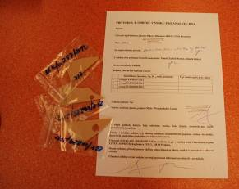
Disadvantages of DNA analysis
Expensive (payment is up to the breeder) – 40-60 Euros for one test in the CZ
Lack of suitable laboratories – no state laboratory in the CZ, only two private
For tortoises and some birds species we have to use foreign laboratoy
Notes:
DNA testing for several Palm cacatoos were done in the UK and the breeder was convicted of cheating and Parrots were seized

Slide 19
And of course…
Some breeders are not very happy

Slide 20
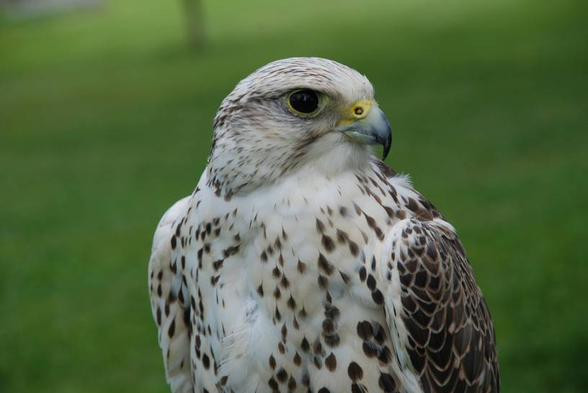
Thank you for your attention
www.nature.cz
barbora.kaminiecka@nature.cz

