Slide 1
“Implementation of CITES and EU Wildlife Trade Regulations in CEE Region”
Vida Posavec Vukelić
Budapest, 16th-18th of June 2014

Slide 2
What’s new?
July 1st 2013. – Croatia joined the EU as 28th Member State
MENP (MA), SINP (SA), CD (ENF) – CITES workshops for customs officers during 2013. and 2014.
over 260 participants
five cities: Zagreb, Rijeka, Split, Osijek, Dubrovnik
topics: new legislation, examples of permits and certificates, customs
procedures, identification of CITES specimens, practical
examples

Slide 3
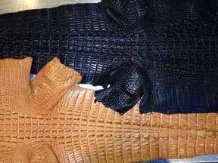
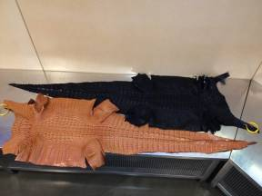
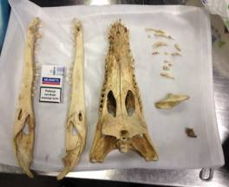
What’s new?
some seizures after workshops:
2 tanned crocodile skins (Crocodylus siamensis) from Thailand
crocodile skull and teeth from Kenya (Crocodylus niloticus ??)

Slide 4
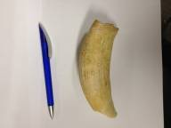
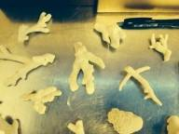
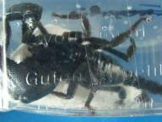
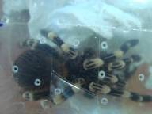
What’s new?
some seizures after workshops:
sperm whale tooth (Physeter macrocephalus)
stone corals from Thailand
emperor scorpion (Pandinus imperator) and Brachypelma species

Slide 5
Internet trade – general situation in Croatia
widespread in Croatia – usually on-line purchase of different specimens (mostly from Europe and the USA):
live animals and plants (exotic pets, orchids...)
products – shoes, bags, etc.
farmaceutical products – i.e. Hoodia pills
2013. – public survey on exotic pets – around 10% of people buy pets via Internet
shipment often without any permit, rarely export permit is presented

Slide 6
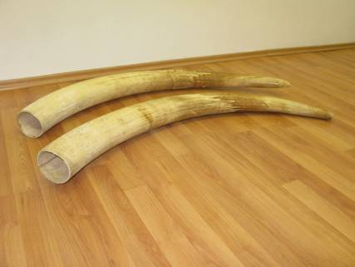
Internet trade – general situation in Croatia
internal situation: many web sites advertise sale of CITES speices, including ivory – tusks were openly sold by private preson

Slide 7
Internet trade – general situation in Croatia
internal situation: wild taken endemic and nationally protected species as well as CITES listed species openly sold:
endemic orchid species
sand lizard (Lacerta agilis)
horned-nose viper (Viper ammodytes)
herman’s tortoise (Testudo hemanni)
etc.

Slide 8
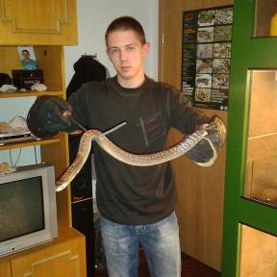
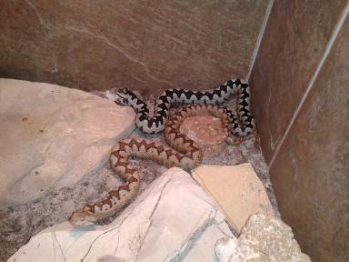
Internet trade – general situation in Croatia
internal situation: facebook pages of breeders and keepers – exchange and sell of surplus animals with breeders in Croatia and neighbouring countries

Slide 9
Internet trade – general situation in Croatia
problems:
no systematic monitoring of Internet trade – SA follow Internet trade but not regulary
NPI is understuffed
it is difficult to find person behind ad

Slide 10
Thank you!

